Slide 1
18CSC301T FORMAL LANGUAGE AND AUTOMATA
UNIT II
Context free grammar and Language

Slide 2
Unit 2
Context Free Grammar
Simplification of CFG
Formal Form
Types
Derivations
Ambiguity
Elimination of useless symbols
Elimination of unit productions
Elimination of Null production
CNF
GNF

Slide 3
Introduction to Grammar

Slide 4
Grammars: Introduction
Grammars denote syntactical rules for conversation in natural languages.
Noam Chomsky gave a mathematical model of grammar in 1956.
A grammar is a set of production rules which are used to generate strings of a language.
A grammar can be represented as 4 tuples (N, T, P, S)
Where,
N:- Set of Non terminals or variable list
T:- Set of Terminals(T∈ ∑)
S:- Special Non terminal called Starting symbol of grammar( S ∈ N)
P:- Production rule ( of the form α → β , where α and β are strings on N ∪ ∑ )

Slide 5
Two basic elements of a Grammar
Terminal symbols
Non-terminal symbols
Terminal Symbols-
Terminal symbols are denoted by using small case letters such as a, b, c etc.
Terminal symbols are those which are the constituents of the sentence generated using a grammar.
Non-Terminal Symbols-
Non-Terminal symbols are denoted by using capital letters such as A, B, C etc.
Non-Terminal symbols are those which take part in the generation of the sentence but are not part of it.
Non-Terminal symbols are also called as variables.

Slide 6
Example
Example: Grammar G1
P1: S → AB
P2: A → a
P3: B → b
G1= (N,T,P,S) = ({S, A, B}, {a, b}, {p1,p2,p3}, S)
Where,
S, A, and B are Non-terminal symbols
a and b are Terminal symbols
S is the Start symbol, S ∈ N
p1,p2,p3 – are Production rules

Slide 7
Types of Grammar

Slide 8
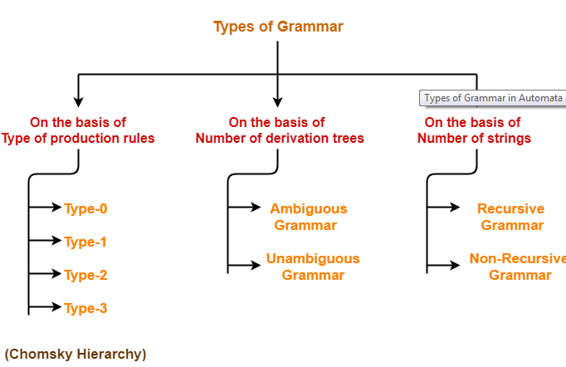
Types of Grammar

Slide 9
Chomosky Hierarchy
According to Noam Chomosky, there are four types of grammars − Type 0, Type 1, Type 2, and Type 3.
Type 0 known as unrestricted grammar.
Type 1 known as context sensitive grammar.
Type 2 known as context free grammar.
Type 3 Regular Grammar.

Slide 10
Type 0: Unrestricted Grammar:
Type-0 grammars include all formal grammars.
Type 0 grammar languages are recognized by Turing Machine.
These languages are also known as the Recursively Enumerable languages.
Grammar Production in the form of α → β
where
α is ( V + T)* V ( V + T)* V : Variables/NT T : Terminals.
β is ( V + T )*.
In type 0 there must be at least one variable on Left side of production.
Example1 : Example2 :
Sab –> ba S → ACaB A –> S. Bc → acB
Here, Variables are S, A and Terminals a, b. CB → DB
aD → Db

Slide 11
Type 1: Context Sensitive Grammar
Type-1 grammars generate the context-sensitive languages.
The language generated by the grammar are recognized by the Linear Bound Automata(LBA)
Rules:
First of all Type 1 grammar should be Type 0.
Grammar Production in the form of α → β
Where,
α , β is ( V + T )+.
| α | <= | β |
i.e count of symbol in α is less than or equal to β
Example: 1 Example: 2 S –> AB AB → AbBc AB –> abc A → bcA B –> b B → b

Slide 12
Type 2: Context Free Grammar:
Type-2 grammars generate the context-free languages.
The language generated by the grammar is recognized by a Pushdown automata (PDA)
Rules:
First of all it should be Type 1.
Left hand side of production can have only one variable.
Grammar Production in the form of α → β
Where,
α is Single NT
β is ( V + T )*.
| α | <= | β |
i.e count of symbol in α is less than or equal to β
Example
S –> AB A –> a/ε B –> b

Slide 13
Type 3: Regular Grammar:
Type-3 grammars generate regular languages.
These languages can be accepted by a finite state automaton (FA)
Type 3 is most restricted form of grammar.
The productions must be in the form
X → Aa/a
X → aA/a
where,
X,A is Non Terminal
a ∈ ∑ *
Example
S->aS/b
S->aS/c
S->Sa/b
A->ba/ ε

Slide 14
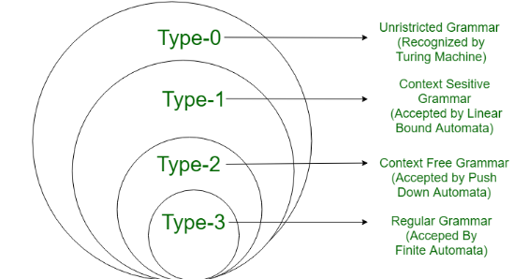
Contd…

Slide 15
CFG and its Languages

Slide 16
Context Free Grammars and Languages
Context free grammar (CFG) is a formal grammar which is used to generate all possible strings in a given formal language.
Context free grammar G can be defined by four tuples as:
(N, T, P, S)
Where,
N:- Set of Non terminals or variable list
T:- Set of Terminals(T∈ ∑)
S:- Special Non terminal called Starting symbol of grammar( S ∈ N)
P:- Production rule ( of the form α → β , where α and β are strings on N ∪ ∑ )
In CFG, the start symbol is used to derive the string.
We can derive the string by repeatedly replacing a non-terminal by the right hand side of the production, until all non-terminal have been replaced by terminal symbols.
It is used to generate all possible patterns of strings in a given formal language.

Slide 17
Examples
Example 1:
Construct the CFG for the language having any number of a's over the set ∑= {a}. R.E= a*
Grammar :Production rule (P):
S → aS rule 1
S → ε rule 2
Derive a string "aaa
-> S
->aS
->aaS rule 1
->aaaS rule 1
->aaa ε rule 2
-> aaa (Required string)

Slide 18
Contd…
Example 2:
Construct a CFG for the regular expression (0 +1)*
Grammar :Production rule (P):
S → 0S | 1S rule 1
S → ε rule 2
Derive a string “1001”
->S
->1S rule 1
->10S rule 1
-> 100S rule 1
-> 1001S rule 1
-> 1001ε rule 2
-> 1001 (Required string)

Slide 19
Contd…
Example 3:
Construct a CFG for defining palindrome over ∑={a,b}, L = {wcwR}
Grammar :Production rule (P):
S → aSa rule 1
S → bSb rule 2
S → c rule 3
Derive a string "abbcbba“
S → aSa
→ abSba from rule 2
→ abbSbba from rule 2
→ abbcbba from rule 3 (Required string)

Slide 20
Contd…
Example 4:
Construct a CFG for defining palindrome over ∑={a,b}
Grammar :Production rule (P):
S → aSa rule 1
S → bSb rule 2
S → a/b/ε rule 3
Derive a string "abbabba“
S → aSa
→ abSba from rule 2
→ abbSbba from rule 2
→ abbabba from rule 3 (Required string)

Slide 21
Contd…
Example 5:
Construct a CFG for set of strings with equal no.of a’s and equal no.of a’s over ∑={a,b}
Grammar :Production rule (P):
S → SaSbS rule 1
S →SbSaS rule 2
S → ε rule 3
Derive a string " babaab “
S → SaSbS from rule 1
→ SbSaaSbS from rule 2
→SbSaS bSaaSbS from rule 2
→ babaab from rule 3 (Required string)

Slide 22
Contd…
Example 6:
Construct a CFG for the language L = a^{n}b^{2n} where n>=1,over ∑={a,b}
Grammar :Production rule (P):
S → aSbb rule 1
S → abb rule 2
Derive a string " aabbbb “
S → aSbb from rule 1
→ aabbbb from rule 2 (Required string)

Slide 23
Contd…
Example 7:
Construct a CFG for the RE=(011+1)* (01)*
Grammar :Production rule (P):
S → AB rule 1
A → ε /CA rule 2
C→ 011/1 rule 3
B → ε /DB rule 4
D → 01 rule 5

Slide 24
Derivation & Parse Tree

Slide 25
Derivations
Starting with the start symbol, non-terminals are rewritten using productions until only terminals remain.
Any terminal sequence that can be generated in this manner is syntactically valid.
If a terminal sequence can’t be generated using the productions of the grammar it is invalid (has syntax errors).
The set of strings derivable from the start symbol is the language of the grammar (sometimes denoted L(G)).
Derivation is a sequence of production rules.
It is used to get the input string through these production rules.

Slide 26
Contd…
During parsing, we need to take the following two decisions.
Need to decide the non-terminal which is to be replaced.
Need to decide the production rule by which the non-terminal will be replaced.
Based on the following 2 derivations, We have two options to decide which non-terminal to be placed with production rule .
Left most Derivation
Right most Derivation
To illustrate a derivation, we can draw a derivation tree (also called a parse tree)

Slide 27
Left most Derivation
In the leftmost derivation, the input is scanned and replaced with the production rule from left to right.
So in leftmost derivation, we read the input string from left to right.
Leftmost non-terminal is always expanded.
Example:
E = E + E Rule1
E = E - E Rule2
E = a | b Rule3
The leftmost derivation is:
W= a - b + a
E = E + E
E = E - E + E
E = a - E + E
E = a - b + E
E = a - b + a

Slide 28
Rightmost Derivation
In rightmost derivation, the input is scanned and replaced with the production rule from right to left.
So in rightmost derivation, we read the input string from right to left.
Rightmost non-terminal is always expanded.
Example:
E = E + E Rule1
E = E - E Rule2
E = a | b Rule3
The rightmost derivation is:
W=a - b + a
E = E - E
E = E - E + E
E = E - E + a
E = E - b + a
E = a - b + a

Slide 29
Parse tree
Parse tree is the graphical representation of symbol. The symbol can be terminal or non-terminal.
In parsing, the string is derived using the start symbol.
The root of the parse tree is that start symbol.
All leaf nodes have to be terminals.
All interior nodes have to be non-terminals.
In-order traversal gives original input string.

Slide 30
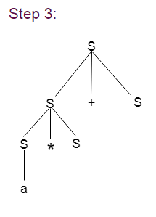
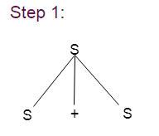
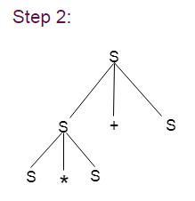
Example:
Grammar G :
S → S + S | S * S
S → a|b|c
Input String : W=a * b + c
Parse Tree for Left most Derivation

Slide 31
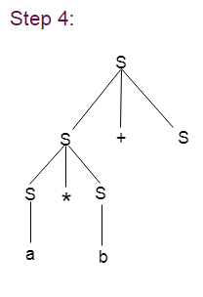
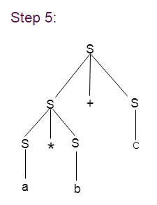
Contd…

Slide 32
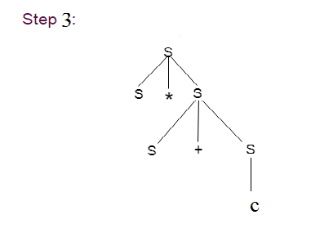
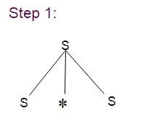
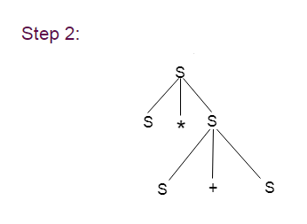
Contd…
Input String : W=a * b + c
Parse Tree for Right most Derivation

Slide 33
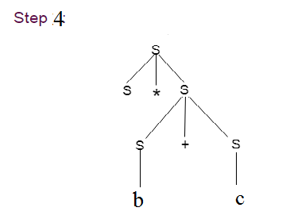
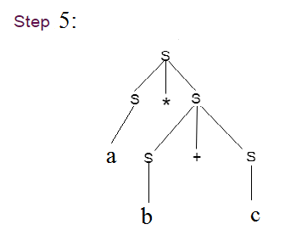
Contd…

Slide 34

What is the language defined by ‘G’
G : S →aS/bS/a/b
L(G) = (a+b)⁺
G : S →XaaX
X →aX/bX/ ε
L(G) = (a+b)* aa (a+b)*
G : S → SS
L(G) =

Slide 35
Contd…
G : S →aca
c →aca/b
S → aca
→ aacaa
→ aaacaaa
→ aaabaaa
L(G) = a^{n} b a^{n}
G : S →0S1/ ε
S → 0S1
→ 0 0S1 1
→ 0 00S11 1
→ 0 0011 1
L(G) = 0^{n} 1^{n} | for n>=0;

Slide 36
Ambiguous grammar

Slide 37
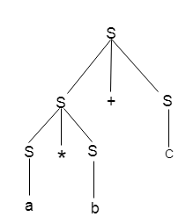
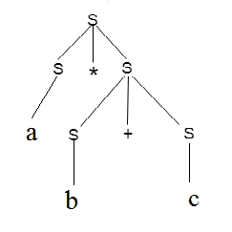
Ambiguity
Example1: Input String : W=a * b + c
Parse Tree for Left most Derivation Parse Tree for Right most Derivation
A grammar is said to be ambiguous if there exists more than one leftmost derivation or more than one rightmost derivative or more than one parse tree for the given input string.

Slide 38
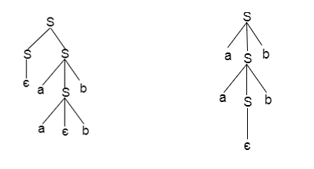
Contd…
Example 2 :
S = aSb | SS
S = ∈
Parse Tree I Parse Tree II

Slide 39
Contd…
If the grammar has ambiguity then it is not good for a compiler construction.
No method can automatically detect and remove the ambiguity but you can remove ambiguity by re-writing the whole grammar without ambiguity.

Slide 40
Ambiguous grammar to unambiguous grammar
Example1:
Show that the given Expression grammar is ambiguous. Also, find an equivalent unambiguous grammar.
Input Grammar:
E → E * E
E → E + E
E → id
Solution:
Let us derive the string "id + id * id"

Slide 41
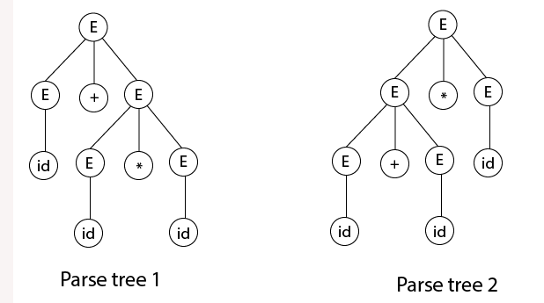
Contd…
As there are two different parse tree for deriving the same string "id + id * id", the given grammar is ambiguous.

Slide 42
Removing ambiguity
Rewriting the grammar
For the Expression Grammar, use the following steps to get unambiguous grammar
Take care of precedence (Use a different non terminal for each precedence level and also start with the lowest precedence (PLUS)
Ensure associativity (define the rule as left recursive if the operator is left associative and as right recursive if the operator is right associative )
The equivalent unambiguous grammar
E → E + T
E → T
T → T * F
T → F
F → id
It reflects the fact that ∗ has higher precedence than +.
Also that, the operators + and ∗ are left-associative as these 2 are left recursive rules.

Slide 43
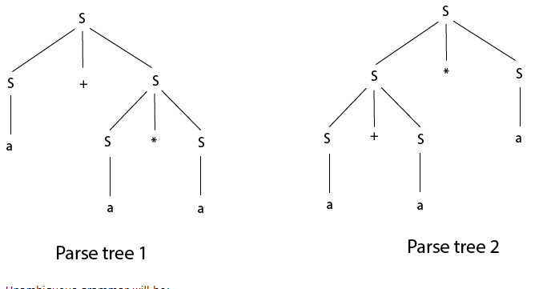
Contd…
Example2:
Check that the given grammar is ambiguous or not. Also, find an equivalent unambiguous grammar.
S → S + S
S → S * S
S → S ^ S
S → a
Solution:
Let us derive the string “a + a * a"

Slide 44
Contd…
The equivalent unambiguous grammar
S → S + A | A
A → A * B | B
B → C ^ B | C
C → a
It reflects the fact that ^ has higher precedence than * and +.
The operators + and ∗ are left-associative as these 2 are left recursive rules.
The operators ^ is right associative as it is right recursive rule.

Slide 45
Elimination of Useless Symbols

Slide 46
Elimination of Useless Symbols
Useful Symbols
A symbol X in a CFG G = {V, T, P, S} is called useful
if there exist a derivation of a terminal string from S where X appears somewhere,
else it is called useless.

Slide 47
Elimination of Useless Symbols
A CFG has no useless variables if and only if all its variables are reachable and generating.
Therefore it is possible to eliminate useless variables from a grammar as follows:
Step 1: Find the non-generating variables and delete them, along with all productions involving non-generating variables.
Step 2: Find the non-reachable variables in the resulting grammar and delete them, along with all productions involving non-reachable variables.

Slide 48
Elimination of Useless Symbols
Generating variables
A variable X is called as generating
- if it derives a string of terminals.
- Note that the language accepted by a context-free grammar is non-empty if and only if the start symbol is generating.
Algorithm to find the non-generating variables in a CFG
Mark a variable X as "generating"
if it has a production X -> w, where w is a string of only terminals and/or variables previously marked "generating".
Repeat the above step until no further variables get marked "generating".
All variables not marked "generating" are non-generating

Slide 49
Elimination of Useless Symbols
Reachable variables
A variable X is called as reachable
if the start symbol derives a string containing the variable X.
Algorithm to find the non-reachable variables in a CFG
Mark the start variable as "reachable".
Mark a variable Y as "reachable" if there is a production X -> w,
where X is a variable previously marked as "reachable" and
w is a string containing Y.
Repeat the above step until no further variables get marked "reachable".
All variables not marked "reachable" are non-reachable

Slide 50
Elimination of Useless Symbols-Example
1. Remove the useless symbol from the given context free grammar
S -> abS | abA | abB
A ->cd
B->aB
C->dc
Solution:
Step 1: Eliminate non-generating symbols i.e non-terminals which do
not produce any terminal string
In the given productions, B do not produce any terminal
Eliminate all the productions in which B occurs.
S -> abS | abA | abB
A ->cd
B->aB
C->dc
Resulting productions are: S -> abS | abA
A -> cd
C -> dc

Slide 51
Elimination of Useless Symbols-Example
Step 2: Eliminate non-reachable symbols i.e non-terminals that can never be reached from the starting symbol
In the set of productions available after Step 2,
‘C’ is not reachable from starting symbol ‘S’
Eliminate productions involving non-terminal ‘C’
S -> abS | abA
A ->cd
C->dc
Final productions after eliminating useless symbols are:
S -> abS | abA
A ->cd

Slide 52
Elimination of Useless Symbols-Example
2. Remove the useless symbol from the given context free grammar
S -> aB / bX A -> Bad / bSX / a B -> aSB / bBX X -> SBD / aBx / ad
Step 1: Eliminate non-generating symbols i.e non-terminals which do
not produce any terminal string
A and X directly derive string of terminals a and ad, hence they are useful. Since X is a useful symbol so S is also a useful symbol as S -> bX.
But B does not derive any terminals, so clearly B is a non-generating symbol.
So eliminate the productions with B
S -> aB / bX A -> Bad / bSX / a B -> aSB / bBX X -> SBD / aBx / ad

Slide 53
Elimination of Useless Symbols-Example
The resulting productions are
S -> bX A -> bSX / a X -> ad
Step 2: Eliminate non-reachable symbols i.e non-terminals that can never be reached from the starting symbol
In the reduced grammar A is a non-reachable symbol
So remove the production involving A
Final grammar after elimination of the useless symbols is S -> bX X -> ad

Slide 54
Elimination of Useless Symbols
Elimination of useful symbols - Order of elimination
Always Eliminate non-generating symbol first and then eliminate non-reachable symbols
Reversing the order of elimination would not work
S -> AB | a A -> aA B -> b
Here A is non-generating, and after deleting A (along with the production S -> AB) the variable B becomes unreachable. Hence, it is considered as useless variable
However, if we would first test for reachability, all variables would be reachable, and subsequently eliminating non-generating variables would leave us with B.

Slide 55
Elimination of Useless Symbols
If a symbol is useful then it is both generating and reachable
Converse of above statement is not true.
For e.g. in CFG
S → ABC
B → b
B is both reachable and generating but still not useful

Slide 56
Elimination of Null Productions

Slide 57
Elimination of Null Productions
Null Productions A production of type A → є is called as Null production
In a given CFG, a non-terminal N is called as nullable
if there is a production N -> ϵ or
If there is a derivation that starts at N and leads to ϵ
If A -> ϵ is a production to be eliminated
look for all productions, whose right side contains A, and
replace each occurrence of A in each of these productions to obtain the non ϵ-productions.
resultant non ϵ-productions must be added to the grammar to keep the language the same.

Slide 58
Elimination of Null Productions – Example
1. Remove the null productions from the following grammar
S -> aX / bX
X-> a / b / є
Solution:
- There is one null production in the grammar X -> ϵ.
- To eliminate X -> ϵ, change the productions containing X in the right side.
- The productions with X in the right side are S -> aX and S -> bX
- So replacing each occurrence of X by ϵ, we get two new productions
S-> a and S -> b
- Adding these productions to the grammar and eliminating X -> ϵ, we get
S -> aX / bX / a / b
X-> a / b

Slide 59
Elimination of Null Productions – Example
2. Remove the null productions from the following grammar
S -> ABAC A -> aA / ϵ B -> bB / ϵ and C -> c
Solution:
We have two null productions in the grammar A -> ϵ and and B -> ϵ
To eliminate A -> ϵ we have to change the productions containing A in the right side.
The productions with A in the right side are S -> ABAC and A -> aA.
So replacing each occurrence of A by ϵ, we get four new productions
S -> ABC / BAC / BC
A -> a
Add these productions to the grammar and eliminate A -> ϵ. S -> ABAC / ABC / BAC / BC A -> aA / a B -> bB / ϵ C -> c

Slide 60
Elimination of Null Productions – Example
To eliminate B -> ϵ we have to change the productions containing B on the right side.
The productions with B in the right side are S -> ABAC / ABC / BAC / BC and B -> bB
Doing that we generate these new productions: S -> AAC / AC / C B -> b Add these productions to the grammar and remove the production B -> ϵ from the grammar. The new grammar after removal of ϵ – productions is: S -> ABAC / ABC / BAC / BC / AAC / AC / C A -> aA / a B -> bB / b C -> c

Slide 61
Elimination of Unit Productions

Slide 62
Elimination of Unit Productions
Unit Production
A unit production is a production A -> B where both A and B are non-terminals.
Unit productions are redundant and hence should be removed.
Follow the following steps to remove the unit production
1. Select a unit production A -> B, such that there exist a production B -> α, where α is a terminal
2. For every non-unit production, B -> α repeat the following step
Add production A -> α to the grammar
3. Eliminate A -> B from the grammar
4. Repeat the above steps , if there are more unit productions

Slide 63
Steps to eliminate unit productions
Every NT is a unit pair of itself (Self pairs)
If (A, B) is a unit pair and →C is an unit production, then (A, C) is also unit pair
Rewrite pairs such that A includes non unit production of C.

Slide 64
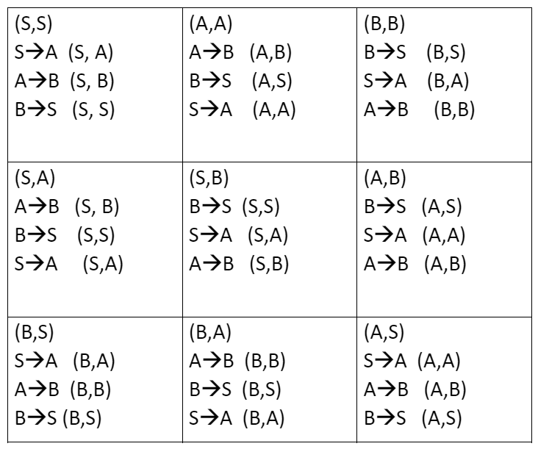
Elimination of Unit Productions – Example
S→A|bb
A→B |b
B→S|a
1. Self pairs: (S,S) (A,A) (B,B)
2. Form unit pairs:
3. Rewrite the rules
(S,S): S→bb
(A,A): A→b
(B,B): B→a
(S,A): S→b
(S,B) S→a
(A,B): A→a
(B,S): B→bb
(B,A): B→b
(A,S): A→bb
Sol:
S→bb|a|b
A→bb|a|b
B→bb|a|b

Slide 65
Exercise Problems
Remove the useless symbols from the given grammar
A -> xyz / Xyzz X -> Xz / xYz Y -> yYy / Xz Z -> Zy / z
2. Remove the useless symbols from the given grammar
T → aaB | abA | aaT
A → aA
B → ab | b
C → ad

Slide 66
Exercise Problems
3. Remove the ε production from the following CFG by preserving the meaning of it.
S → XYX
X → 0X | ε
Y → 1Y | ε
4. Remove the ε production from the following CFG by preserving the meaning of it.
S → ASA | aB | b
A → B
B → b | ∈

Slide 67
Exercise Problems
5. Identify and remove the unit productions from the following CFG S -> S + T/ T T -> T * F/ F F -> (S)/a
6. Remove the unit productions from the following grammar S -> AB A -> a B -> C / b C -> D D -> E E -> a

Slide 68
Normal Form

Slide 69
Normal Form
Normalization is the process of minimizing redundancy from a relation or set of relations.
A grammar is said to be in normal form when every production of the grammar has some specific form
In this course we are going to study 2 types of Normal form
Normal Form
Chomsky normal form (CNF)
Greibach normal form (GNF)

Slide 70
Chomsky normal form (CNF)

Slide 71
Chomsky normal form (CNF)
A context free grammar (CFG) is in Chomsky Normal Form (CNF) if all production rules satisfy one of the following conditions:
S → ε
NT→ T (Eg. A → a)
NT → NT NT (Eg. A →SE)
Let consider,
NT = Non terminal (Eg. A,S,E..)
T = Terminal (Eg. a,b,0,1--)

Slide 72
Steps to convert a CFG to CNF
Eliminate null, unit and useless productions (Kindly refer previous slides).
Eliminate terminals from RHS if they exist with other terminals or non-terminals.
Example:
Consider A → aX
Then we can convert to CNF form such as
Let Z → a
A → ZX
CNF Normal form
NT→ T
NT → NT NT

Slide 73
Steps to convert a CFG to CNF
Eliminate RHS with more than two non-terminals.
Example:
Consider A → BDX
Then we can convert to CNF form such as
Let Z → BD
A → ZX
CNF Normal form
NT→ T
NT → NT NT

Slide 74
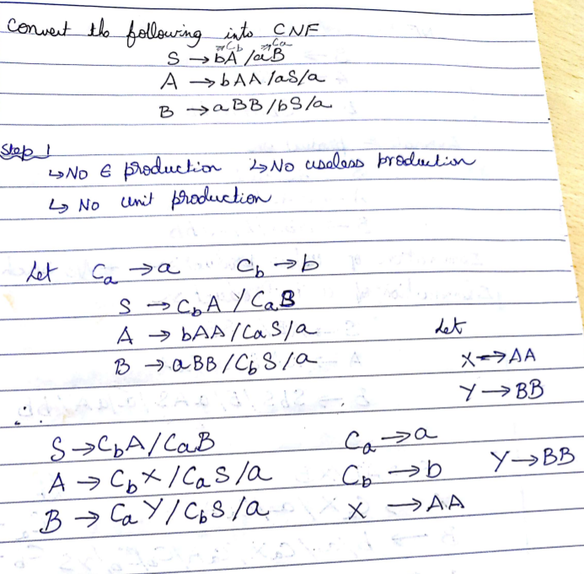
Solved problem
CNF Normal form
NT→ T
NT → NT NT

Slide 75
CNF Problem
Define the two normal forms that are to be converted from a context free grammar(CFG). Convert the following CFG to Chomsky normal form:
S→A/B/C
A→aAa/B
B→bB/bb
C→baD/abD/aa
D→ aCaa/D
Construct the following grammar in CNF:
S→ ABC/BaB
A →aA/BaC/aaa
B →bBb/a/D
C →CA/AC
D→ ε

Slide 76
CNF Problem
Convert the following grammar into CNF
S → cBA
S → A
A → cB | AbbS
B → aaa
Construct a equivalent grammar G in CNF for the grammar G1 where
G1=({S,A,B},{a,b},{S →ASB/ ε , A→ aAS/a, B→ SbS/A/bb},S)

Slide 77
Greibach Normal Form (GNF)

Slide 78
Greibach Normal Form (GNF)
GNF stands for Greibach normal form. A CFG(context free grammar) is in GNF(Greibach normal form) if all the production rules satisfy one of the following conditions:
S → ε
NT→ T (Eg. A → a)
NT → T (NT)* (Eg. A →aSBBA)
Let consider,
NT = Non terminal (Eg. A,S,E..)
T = Terminal (Eg. a,b,0,1--)

Slide 79
Steps to convert a CFG to GNF
Convert the given grammar into CNF form
Rename the Non Terminal as (A1,A2,A3,....)
For the grammar A_{i} →A_{j,} perform the following:
If i<j, leave the grammar as such
If i>j, then substitute A_{j} in A_{i}
If i=j, then introduce a new variable B_{i} and modify the production A_{i} →A_{j} β | α as
B_{i} → β | β B_{i}
A_{i} → α | α B_{i}
4. Now, some productions will be in GNF. Rewrite other productions also to be in GNF.

Slide 80
Lemma I
If G = (V,T,P,S) is a CFG and, the set of ‘A’ production belong to P are
A → Aα ------ (1)
A → β₁ | β₂ | β₃ | β₄ ₋₋₋₋₋ | β_{n} ------ (2)
then Let G’ = (V’,T,P’,S)
Where P’ be
A → β₁ α | β₂ α | β₃ α | β₄ α ₋₋₋₋₋ | β_{n} α
By sub. (2) in (1)

Slide 81
Lemma II
If G = (V,T,P,S) is a CFG and, the set of ‘A’ production belong to P are
A → Aα₁ | Aα₂ | Aα₃ ₋₋₋₋₋| Aα_{m} | β₁ | β₂ | β₁ ------ | β_{n}
Then introduce a new non-terminal X
So,Let G’ = (V’,T,P’,S) , Where V’ = (V ∪ X)
Where P’ can be formed
A → β_{i} (1 ≤ i ≤ n)
A → β_{i} X
1
X → α_{j} (1 ≤ j ≤ m)
X → α_{j} X
2

Slide 82
Solved problem (1)
GNF form
S → ε
NT→ T (Eg. A → a)
NT → T (NT)* (Eg. A →aSBBA)
Convert the following to GNF
S→AB
A →BS|b
B →SA|a
Solution:
Step 1 & 2 : The given grammar is in CNF form
Step 3: Renaming the production, Let S = A_{1 ,}A = A_{2 ,}B = A₃
A₁ → A₂ A₃ ---- (1)
A₂ → A₃ A₁ |b ---- (2)
A₃ → A₁ A₂ |a ---- (3)
CNF form
S → ε
NT→ T (Eg. A → a)
NT → NT NT (Eg. A →SE)
Step 4: While checking the condition A_{i} →A_{j} where(i ≤ j)
Equation(3) is not in the format , so as per Lemma I let us Sub. The value of A₁ from (1) to (3), so
A₃ → A₂ A₃ A₂ |a ---- (4)
Lemma 1
A → Aα ------ (1)
A → β₁ | β₂ | β₃ | β₄ ₋₋₋₋₋ | β_{n} ------ (2)
A → β₁ α | β₂ α | β₃ α | β₄ α ₋₋₋₋₋ | β_{n} α

Slide 83
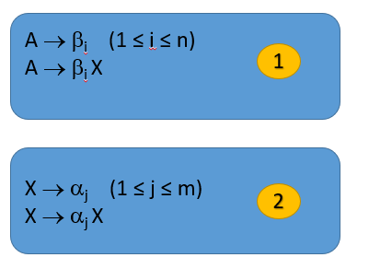
Solved problem (1)
Lemma 2
A → Aα₁ | Aα₂ | Aα₃ ₋₋₋₋₋| Aα_{m} | β₁ | β₁ ------ | β_{n}
Again as per Lemma I sub. The value of A₂ from equ. (2) in (4), we may get
A₃ → A₃ A₁ A₃ A₂ |b A₃ A₂ |a ---- (5)
So, Now let solve by Lemma 2,
A₃ → A₃ A₁ A₃ A₂ |b A₃ A₂ |a ---- (5)
Now sub (6) & (7) in (2)
A₂ → b A₃ A₂ A₁ | aA₁ | b A₃ A₂X A₁| aX A₁|b ---- (10)(GNF)
Now Sub (10) in (1)
A₁ → b A₃ A₂ A₁ A₃ | aA₁ A₃ | b A₃ A₂X A₁ A₃ | aX A₁ A₃ |bA₃ ---- (11)(GNF)
Now sub (11) in (8)&(9)
X→ b A₃ A₂ A₁ A₃ A₃ A₂ | aA₁ A₃ A₃ A₂ | b A₃ A₂X A₁ A₃ A₃ A₂ | aX A₁ A₃ A₃ A₂ |bA₃ A₃ A₂ ---- (12) (GNF)
X→ b A₃ A₂ A₁ A₃ A₃ A₂X | aA₁ A₃ A₃ A₂X | b A₃ A₂X A₁ A₃ A₃ A₂X | aX A₁ A₃ A₃ A₂ X|bA₃ A₃ A₂X ---- (13) (GNF)
A
α
β
A₃ → b A₃ A₂ |a ---- (6) (GNF)
A₃ → b A₃ A₂X |aX ---- (7) (GNF)
X→ A₁ A₃ A₂ ---- (8)
X→ A₁ A₃ A₂X ---- (9)
Answer:
A₁ → b A₃ A₂ A₁ A₃ | aA₁ A₃ | b A₃ A₂X A₁ A₃ | aX A₁ A₃ |bA₃
A₂ → b A₃ A₂ A₁ | aA₁ | b A₃ A₂X A₁| aX A₁|b
A₃ → b A₃ A₂ |a
A₃ → b A₃ A₂X |aX
X→ b A₃ A₂ A₁ A₃ A₃ A₂ | aA₁ A₃ A₃ A₂ | b A₃ A₂X A₁ A₃ A₃ A₂ | aX A₁ A₃ A₃ A₂ |bA₃ A₃ A₂
X→ b A₃ A₂ A₁ A₃ A₃ A₂X | aA₁ A₃ A₃ A₂X | b A₃ A₂X A₁ A₃ A₃ A₂X | aX A₁ A₃ A₃ A₂ X|bA₃ A₃ A₂X

Slide 84
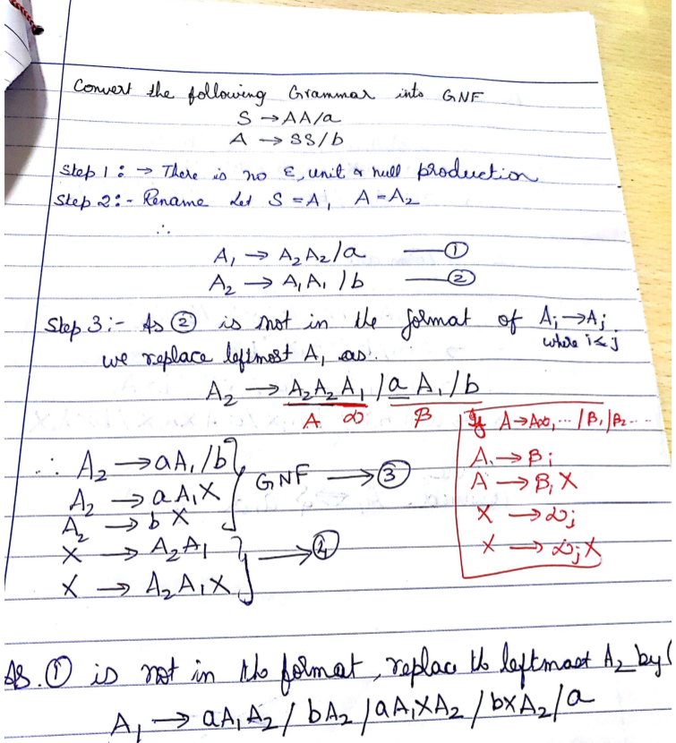
Solved problem (2)

Slide 85
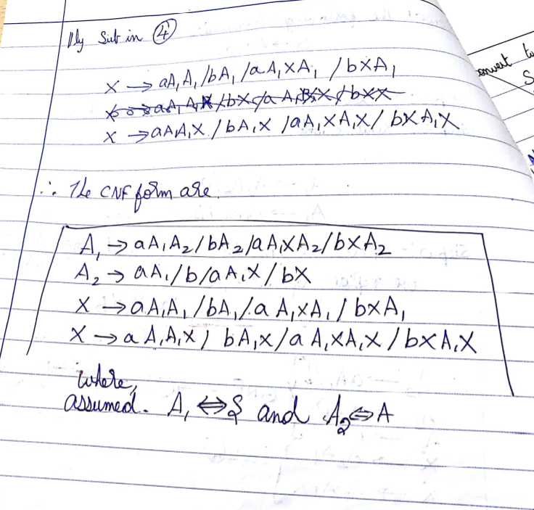
Solved problem (2)

Slide 86
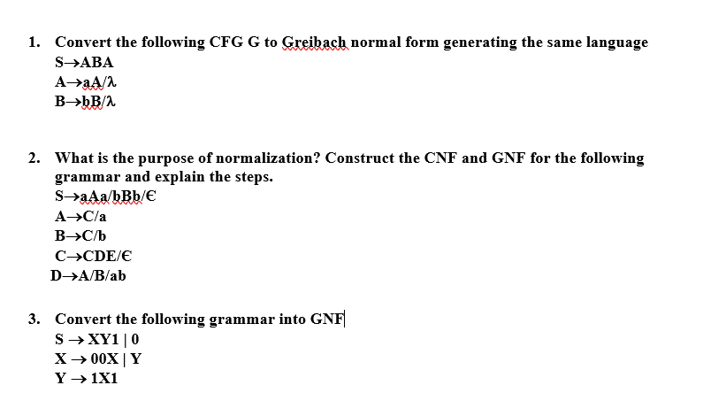
Exercise problems

